Slide 1

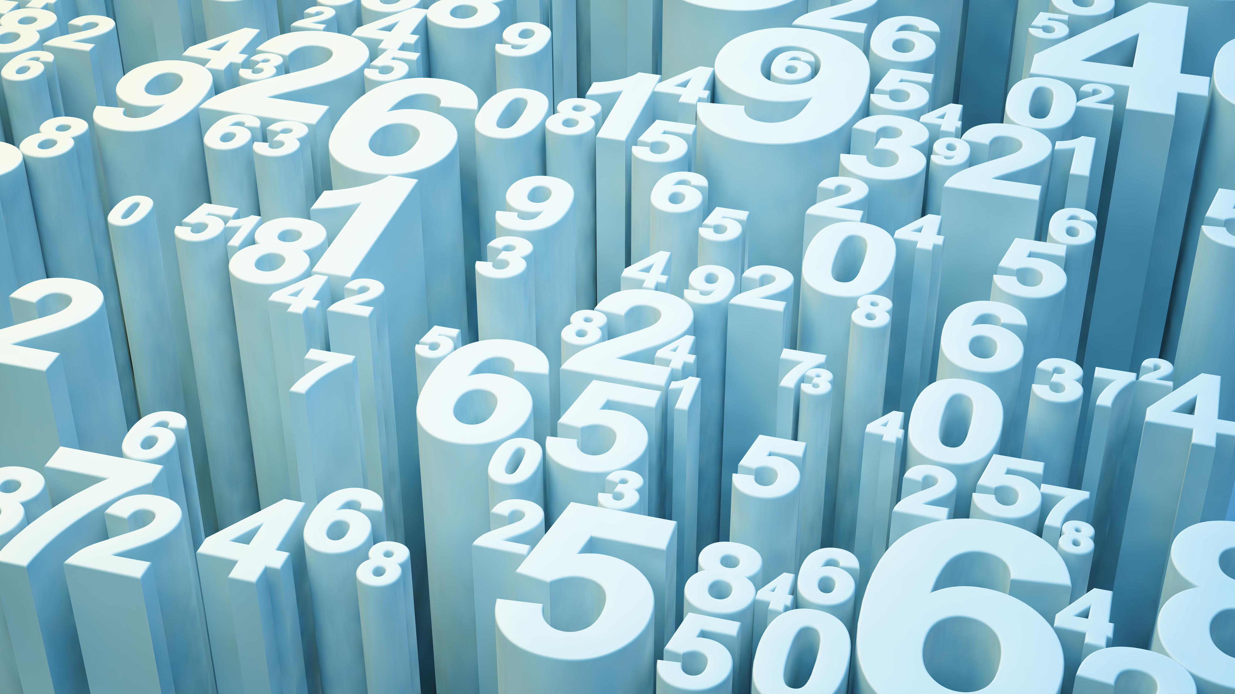
Optimization Of Energy In Smart Grid using fourier-transfoRm.
BY:
Manaswin Manoj
Manjesh Kalmani
Mohammed Yaseen Sutar
Vishnu . MD
Nishat N Shahu

Slide 2
TABLE OF CONTENT:
1. SMART GRID INTRODUCTION
2. FOURIER TRANSFORM
3. ALGORITHM
4. FUNCTION USED
5. CODE
6. OUTPUT
7. APPLICATIONS

Slide 3
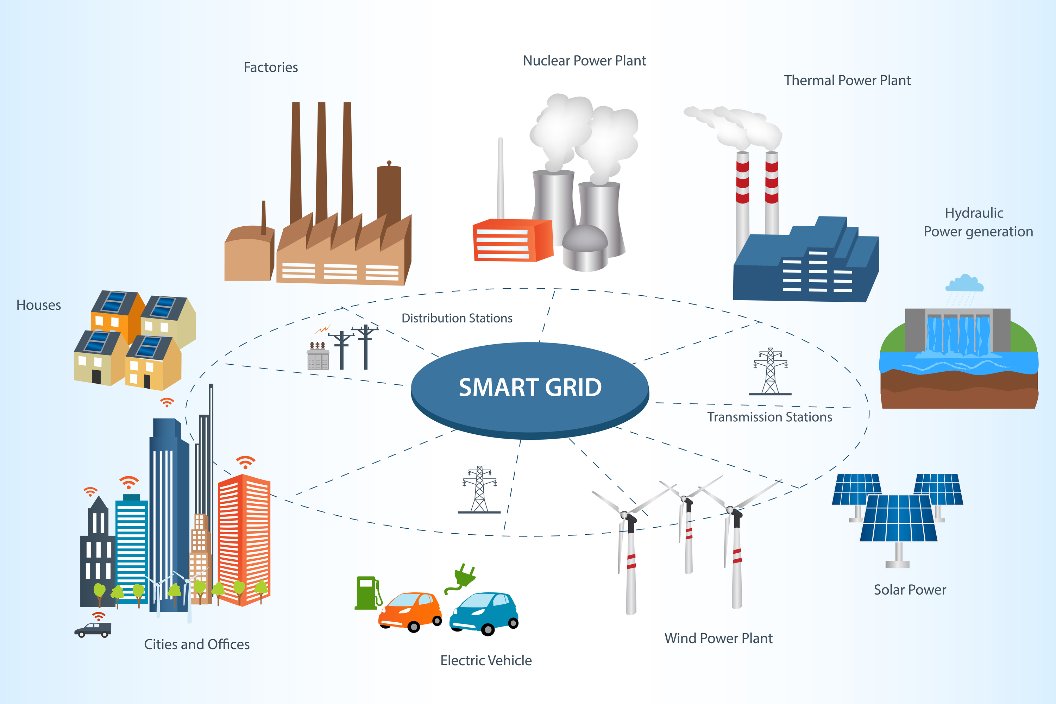
Smart Grid technology:
Smart grids represent a transformative evolution in the traditional power distribution system, integrating advanced communication, control, and monitoring technologies to create a more efficient and adaptable energy infrastructure.
By enabling two-way communication between utilities and
consumers, smart grids optimize energy usage, enhance reliability,
and accommodate the growing integration of renewable energy sources.
Real-time data analytics empower smart grids to facilitate efficient
energy management, reduce outages, and support the increasing
adoption of electric vehicles, contributing to a more sustainable and
resilient energy eco-system.
Moreover, smart grids also enable demand response programs, allowing consumers to actively participate in energy conservation efforts and contribute to load management during peak usage periods. This active involvement of consumers in energy management fosters a more dynamic and responsive energy system.
Overall, smart grids are pivotal in revolutionizing the energy landscape, shaping a more resilient, eco-friendly, and adaptable power infrastructure that can meet the evolving needs of modern society while promoting sustainability and efficiency.

Slide 4
FOURIER TRANSFORM :
“Fourier transforms are mathematical operations that decompose a complex signal into its constituent frequencies. They are widely used in various fields, including signal processing, image analysis, and data compression. In the context of smart grids, Fourier transforms can be utilized to optimize energy management and forecasting”.
The need to use Fourier transformation in smart grid optimization arises from the requirement to analyze and process complex electrical signals efficiently.
Smart grid design necessitates the optimization of various system components, including metering, protection devices, load schedules, and energy disaggregation.
Fourier transformation plays a crucial role in this optimization process by enabling the decomposition of signals into their frequency components, allowing for a comprehensive understanding of the grid's dynamic behavior and the identification of harmonic distortions and power quality issues.
Furthermore, the application of Fourier transformation facilitates the analysis of energy signals and the optimization of load schedules, contributing to enhanced energy management within smart grids.
Additionally, research interests in optimization algorithms for smart grids often involve Fourier transforms, highlighting their significance in addressing the complexities of grid systems.
Overall, the utilization of Fourier transformation in smart grid optimization is essential for effectively managing and enhancing the performance of modern power distribution systems.

Slide 5
ALGORITHM:
To optimize energy consumption patterns in smart grid systems and integrate renewable energy sources efficiently, Fourier transforms can be employed for frequency analysis of energy consumption data. Here's a step-by-step approach to developing a smart grid optimization algorithm using Fourier analysis:
Generate Synthetic Energy Data:
Generate a time array, time, with num_points data points and a specified sampling_rate.
Generate synthetic energy consumption data, original_energy_data, by combining a sinusoidal wave with the given frequency and amplitude and adding random noise scaled by noise_factor.
Apply Fourier Transform:
Use the np.fft.fft function to compute the Fourier transform of the original_energy_data.
Obtain arrays frequencies and energy_fft, representing frequencies and Fourier coefficients, respectively.
Filter High-Frequency Components:
Create a copy of the energy_fft array to preserve the original Fourier coefficients.
Set Fourier coefficients to zero for frequencies greater than the specified frequency_threshold. Obtain the filtered Fourier coefficients in the array energy_fft_filtered.
Obtain the filtered Fourier coefficients in the array energy_fft_filtered.
Optimize Smart Grid:
Use the np.fft.ifft function to perform the inverse Fourier transform on the filtered coefficients, obtaining the optimized energy consumption data, optimized_energy_data.
Return time, original_energy_data, and optimized_energy_data.

Slide 6
ALGORITHM:
Example Usage:
Set input parameters, such as sampling_rate, frequency_threshold, and generate synthetic energy data using the provided algorithm.
Call the optimize_smart_grid function with the original energy data and parameters.
Plot the original and optimized energy consumption data using Matplotlib for visualization.
This algorithm combines elements of signal processing, mathematics, and data analysis to optimize energy consumption patterns in a smart grid using Fourier analysis. It can serve as a foundation for understanding how frequency analysis contributes to enhancing energy efficiency in real-world applications.
Input:
num_points: Number of data points in the energy consumption dataset.
sampling_rate: The rate at which data is sampled (measured) over time.
frequency: Fundamental frequency of the energy consumption pattern.
amplitude: Amplitude of the energy consumption pattern.
noise_factor: Amplitude of the random noise added to the energy data.
frequency_threshold: Threshold for filtering out high-frequency noise.
Output:
time: Array representing time.
original_energy_data: Original energy consumption data.
optimized_energy_data: Optimized energy consumption data.

Slide 7
functions used:
In the provided code, the functions np.fft.fftfreq and np.fft.fft are used to perform the Fourier analysis on the energy consumption data. Let me explain their roles in the context of the algorithm:
1. np.fft.fftfreq Function:
Purpose: This function is used to generate an array of frequencies corresponding to the Fourier transform components. It helps map the values obtained from the Fourier transform to their corresponding frequencies.
Parameters: The function takes two parameters - the first is the number of points (n), and the second is the sampling interval (d). In the code, n is the length of the energy data, and d is the inverse of the sampling rate (1/sampling_rate).
Output: The function returns an array of frequencies.
2. np.fft.fft Function:
Purpose: This function computes the one-dimensional discrete Fourier Transform. In this context, it is used to transform the original energy consumption data from the time domain to the frequency domain.
Parameters: The function takes an array (in this case, the energy_data array) as input.
Output: The function returns an array representing the Fourier transform of the input.

Slide 8
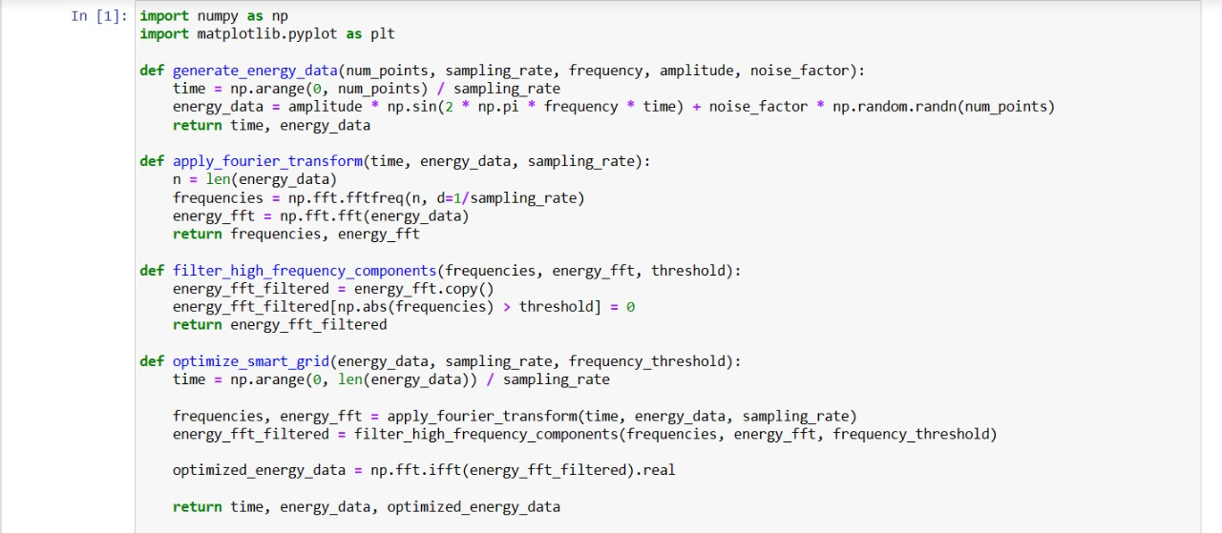
Code

Slide 9
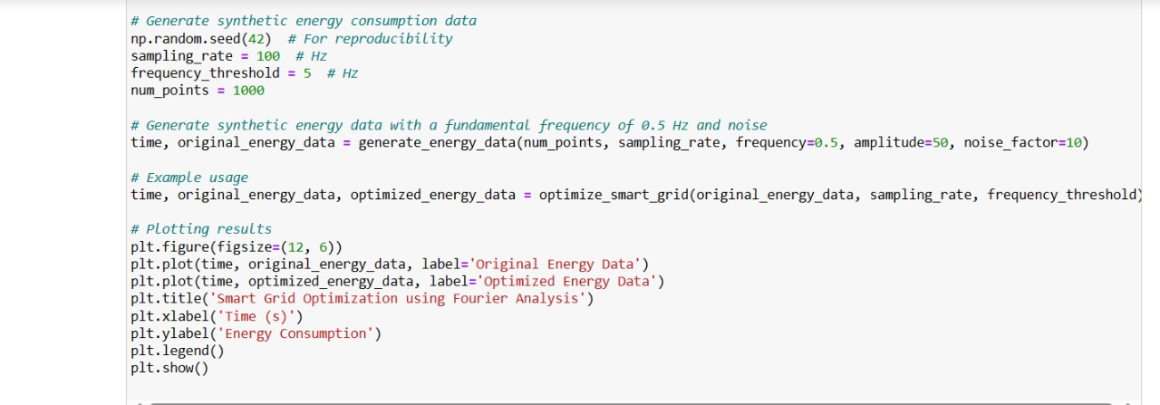
Code

Slide 10
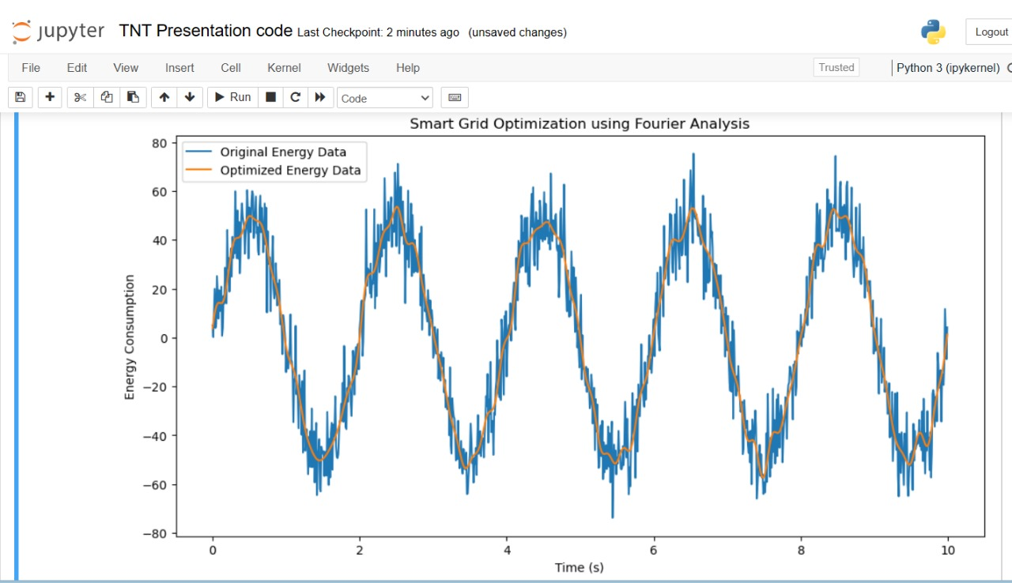
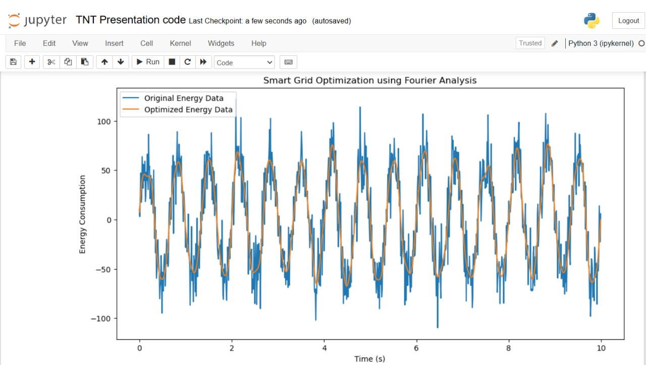
Output
Inputs given:
np.random.seed(42) # For reproducibility
sampling_rate = 100 # Hz
frequency_threshold = 5 # Hz
num_points = 1000
frequency=0.5,
amplitude=50,
noise_factor=10
Inputs given:
np.random.seed(42) # For reproducibility
sampling_rate = 100 # Hz
frequency_threshold = 5 # Hz
num_points = 1000
frequency=1.5
amplitude=60
noise_factor=20

Slide 11
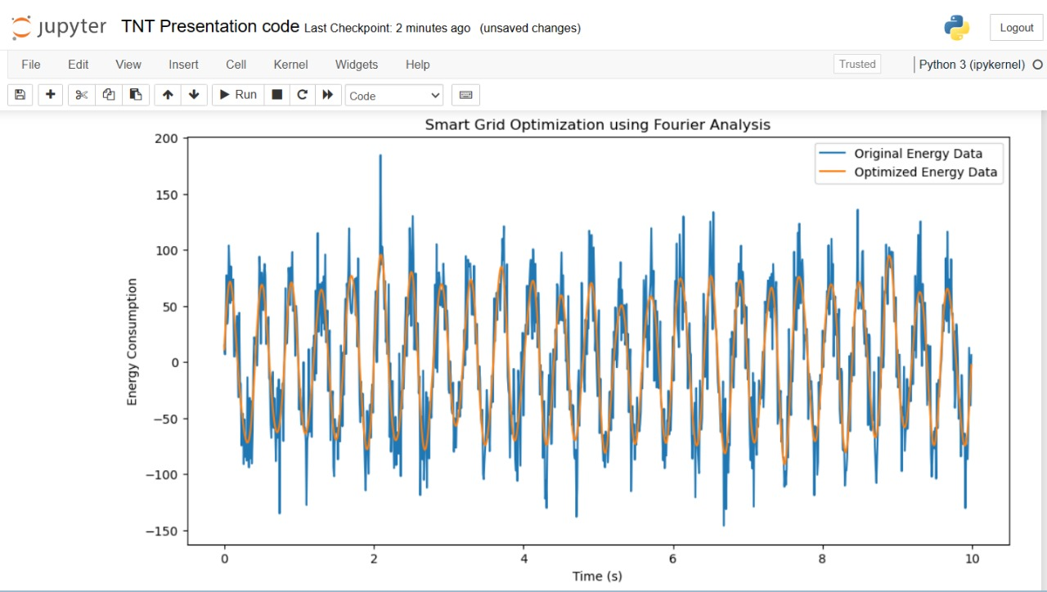
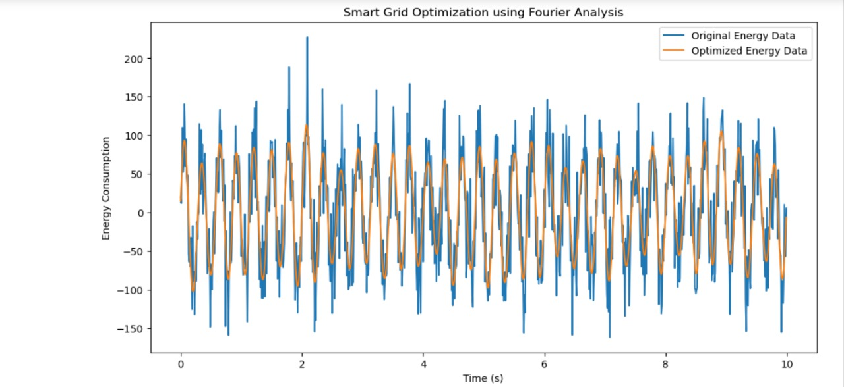
Output
Inputs given:
np.random.seed(42) # For reproducibility
sampling_rate = 100 # Hz
frequency_threshold = 5 # Hz
num_points = 1000
frequency=2.5
amplitude=70
noise_factor=30
Inputs given:
np.random.seed(42) # For reproducibility
sampling_rate = 100 # Hz
frequency_threshold = 5 # Hz
num_points = 1000
frequency=3.5
amplitude=80
noise_factor=40

Slide 12
APPLICATIONS:
Fourier transforms are mathematical operations that decompose a complex signal into its constituent frequencies. They are widely used in various fields, including signal processing, image analysis, and data compression.
The Fourier transform is used in the smart grid for various purposes, including:
Phase Identification: It helps identify the phase of smart meters by analyzing the time series data from the meters.
Estimating Non-sinusoidality: The Fourier transform, along with windowing techniques, helps estimate non-sinusoidal components in power signals to analyze power quality.
3. Frequency Domain Representation: By applying the Fourier transform, power signals can be represented in the frequency domain, enabling the identification of harmonics and other frequency-related characteristics.
4. Privacy-Preserving Publication: Fourier coefficients can be utilized in privacy-preserving techniques for publishing time-series data while safeguarding privacy.
5. Signal Processing Techniques: The Fourier transform is employed in signal processing techniques like sliding window reconstruction DFT (SWR-DFT) for time-varying harmonic analysis, load forecasting, and privacy protection algorithms.

Slide 13
THANK YOU

